Slide 1

Deployment and Version Control
SoftUni Team
Technical Trainers
Software University
https://softuni.org

Slide 2
Table of Contents
Git
Github
Deployment in Heroku
2
Notes:
2

Slide 3
Have a Question?
sli.do
#python-web
Notes:
3

Slide 4

Git
Distributed Source-Control System

Slide 5
What is Git?
Distributed source-control system
The most popular in the world
Free, open-source software
Works with local and remote repositories
Git bash - command line interface for Git
Runs on Linux, macOS and Windows (msysGit)
https://git-scm.com
https://www.atlassian.com/git/tutorials/setting-up-a-repository

Slide 6
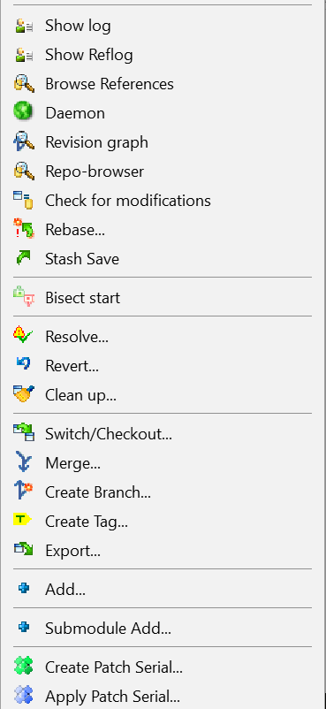
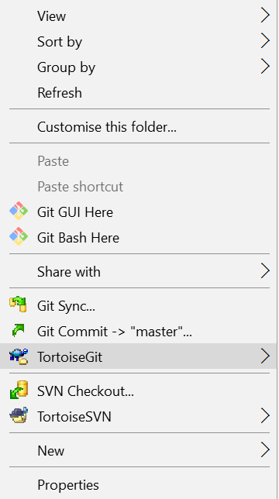
Using Git
Console-based Client
git, GitBash
Windows GUI Client - TortoiseGit
https://tortoisegit.org/download/
GitHub Desktop Client
https://desktop.github.com

Slide 7
Installing Git
msysGit installation on Windows
Download Git for Windows: https://git-scm.com/downloads
Options to select (they should be selected by default)
"Use Git Bash Only"
"Checkout Windows-style, commit Unix-style endings"
Git Installation on Linux
sudo apt-get install git

Slide 8
Basic Commands
Cloning an existing Git repository
Fetch and merge the latest changes from the remote repository
Preparing (adding / selecting) files for a commit
Committing to the local repository
git clone [remote url]
git pull
git add [filename] ("git add ." adds everything)
git commit –m "[your message here]"

Slide 9
Basic Commands (2)
Check the status of your local repository (see the local changes)
Creating a new local repository (in the current directory)
Creating a remote (assign a short name for remote Git URL)
Pushing to a remote (send changes to the remote repository)
git status
git init
git remote add [remote name] [remote url]
git push [remote name] [local name]

Slide 10

GitHub
World's Largest Source Code Hosting Site

Slide 11
What is GitHub?
GitHub is the world's #1 source code hosting site
Free for open-source projects
Paid plans for private repositories
GitHub provides:
Git source code repository
Issue tracker (bug tracker)
Project board (Kanban style)
Wiki pages (documentation)

Slide 12

Deployment

Slide 13

What is Deployment?
Deployment means to push changes or update from one environment to another

Slide 14
Where to deploy a Python Project?
We can deploy one project onto multiple websites
Some of the deployment websites
Heroku
Amazon Web Services (AWS)
PythonAnywhere

Slide 15
Deploying on Heroku
There are 3 ways to deploy a project on Heroku
Using Git (Heroku Git, Heroku CLI)
Using Github
Using the Container Registry (Heroku CLI)

Slide 16
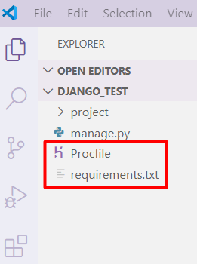
Deploying on Heroku (2)
Before running our project, we should add 3 important keys to deploy the project
First, add "gunicorn" to pip
Next, create 2 new files in our outer project folder
Procfile
requirements.txt

Slide 17
Deploying on Heroku (3)
Requirements
Holds all of your packages and their versions
To add your packages
Procfile
Holds the executed commands by the application on startup
Should include
pip freeze > requirements.txt
web: gunicorn <name_of_project_folder>.wsgi

Slide 18
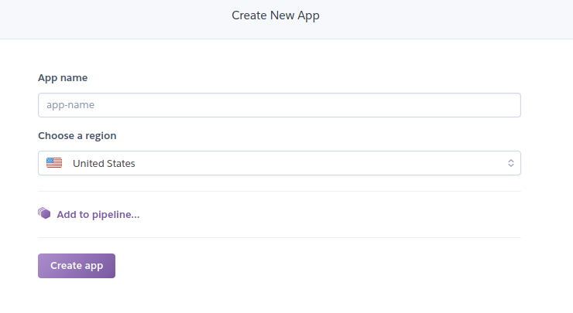
Deploying on Heroku (4)
In Heroku, after creating a profile, you will be redirected to the dashboard

Slide 19
Deploying on Heroku (5)
After creating your application in Heroku, you will see 3 methods for deployment
We will deploy our application with Heroku Git
We can use our existing repository to deploy our application or we can create a new repository

Slide 20
Deploying on Heroku (6)
Download Heroku CLI
In the terminal, write this command
For creating a new Git repository
Go to the directory of our project
In the terminal, write
heroku login
git init
heroku git:remote –a name_of_your_heroku_project

Slide 21

Deploying on Heroku (7)
For using an existing repository
Write in the terminal
Now, you can see your project on this address
name_of_heroku_project.herokuapp.com
heroku git:remove –a name_of_heroku_project

Slide 22

Live Demo
Deploying a Project on Heroku

Slide 23
Additional Resources
Uploading project using Docker and Amazon Web Services
https://softuni.bg/trainings/resources/video/56041/video-03-december-2020-doncho-minkov-python-web-framework-november-2020/3180

Slide 24

Summary
Git is a source-control system
Github is a source code hosting site
There are 3 ways of deploying our app in Heroku
Git
Github
Container Registry
Notes:
24

Slide 25
Questions?
Notes:
25

Slide 26













SoftUni Diamond Partners

Slide 27


Educational Partners

Slide 28

License
This course (slides, examples, demos, exercises, homework, documents, videos and other assets) is copyrighted content
Unauthorized copy, reproduction or use is illegal
© SoftUni – https://softuni.org
© Software University – https://softuni.bg
Notes:
28

Slide 29
Trainings @ Software University (SoftUni)
Software University – High-Quality Education, Profession and Job for Software Developers
softuni.bg, softuni.org
Software University Foundation
softuni.foundation
Software University @ Facebook
facebook.com/SoftwareUniversity
Software University Forums
forum.softuni.bg
Notes:
29

